Slide 1
Armario
A Digital Wardrobe

Slide 2
What can it do?
Store all your clothing data
Classify the clothing item
View your complete wardrobe
Suggest your travel gear

Slide 3
IBM BLUemix services used-
Weather Company Data - to fetch the weather details of a location based on pincode and country code.
Visual Recognition API - To check for details(cloth type, etc.) in the uploaded image.
Cloud Foundry (python-flask) - to host the server (host working at the time of upload)
Alchemy News data API - to find the latest news of a paricular place
Kinetise - to build the client UI (Any application can be used as long as the requests format is correct)

Slide 4
How does it work?
Upload the images of all the clothes in your wardrobe
View them at your convenience
Take suggestions before your travel
Get latest news feed of the place where you are travelling to.

Slide 5
Business / E-commerce uses
The data can be used to improve the recommender systems implemented by the various shopping websites.
We can start predicting per day wearables once more data is collected from an user. The classifier will need to be trained on data of each user.
Groups can be created of similar choices which will again help ecommerce.

Slide 6
How can the app be improved!
More user-friendly and dynamic UI.
Clothing suggestions.
Integration with Ecommerce if a user wants.
More variations in the clothing items. Better classification of the images.

Slide 7
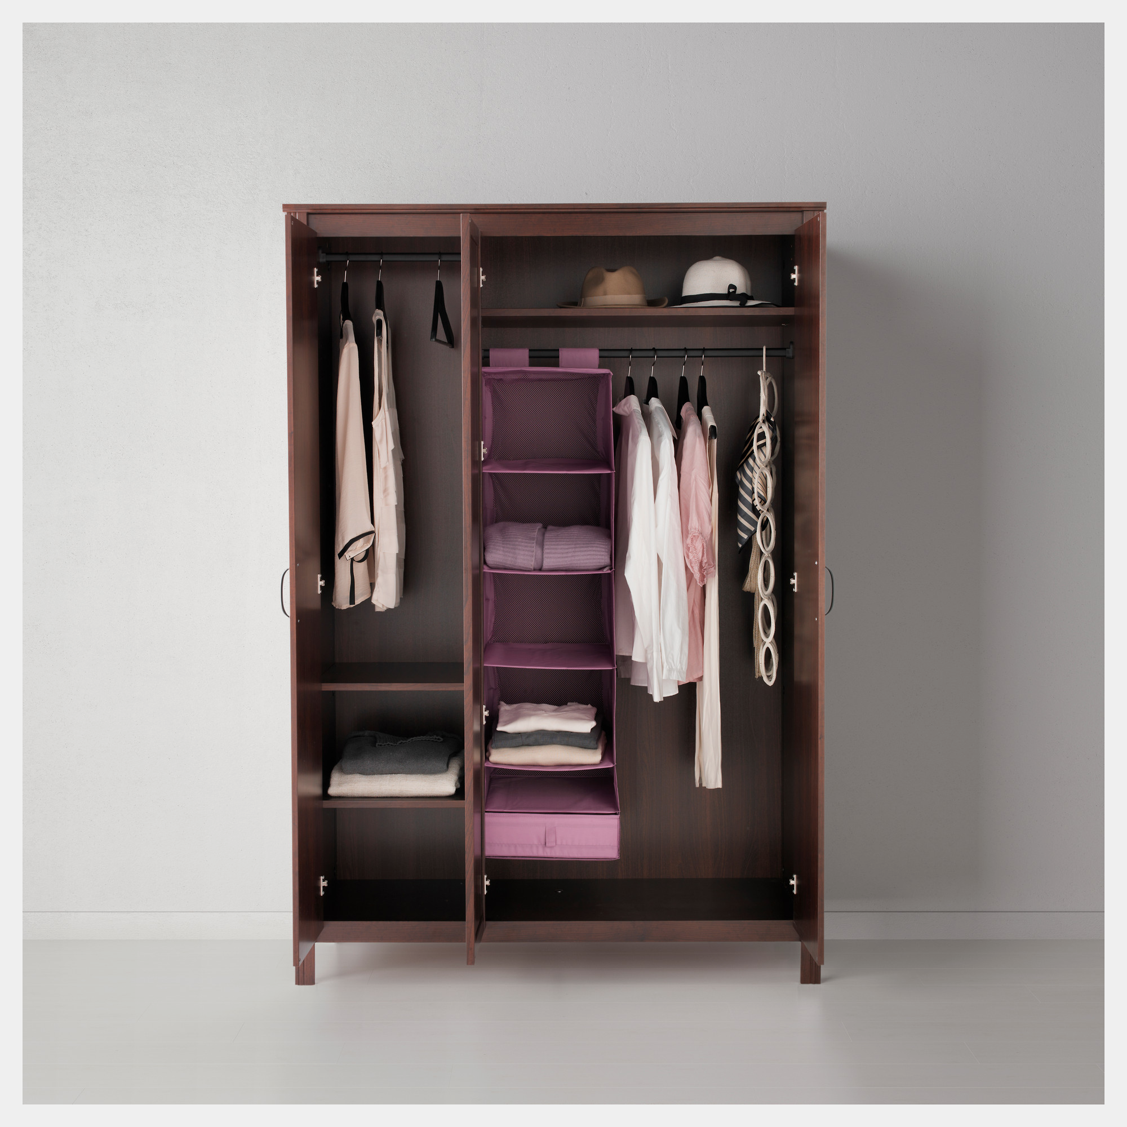
THank you!

